Slide 1
Statistical Methods in Data Analysis
OCE2901 – Surf Engineering Analysis

Slide 2


Preamble
Let’s discuss your field experiment procedures

Slide 3

Introduction: What is statistical analysis?
The study of numerical data through various techniques in order to answer a research question
Used for:
Measuring differences
Assessing relationships
Testing and proving (or disproving) hypotheses

Slide 4
Basic Terminology
Descriptive Statistics
Describes the relationship between variables;
Inferential Statistics
The data are analyzed in samples to make inferences on the larger population
provides a summary of data in the form of mean, median, and mode;
Analyses data via distributions
Numerical Data
Data with continuous, numerical range of values
Categorical Data
Data with discreet bins or categories of values

Slide 5
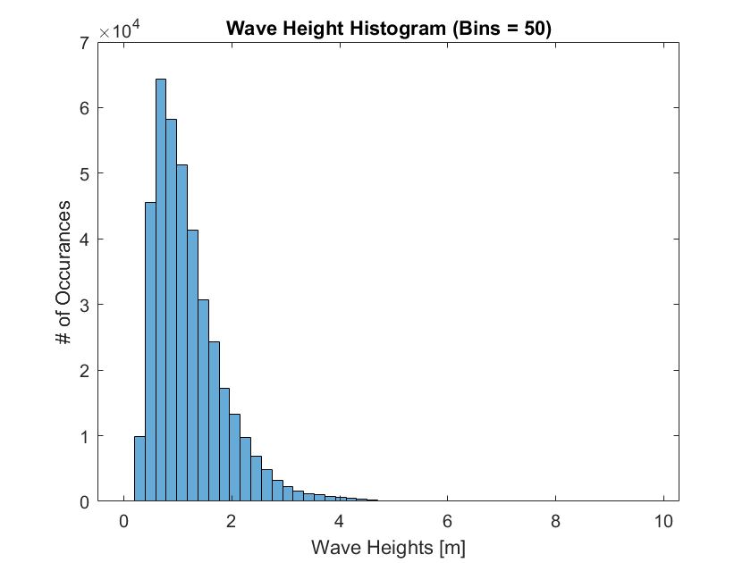
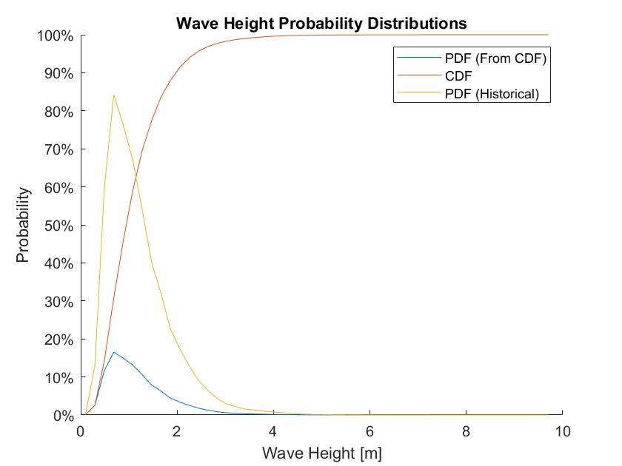
Percentage Frequency Distribution
What else could this graph look like? How else can you represent the percentage of something occurring?

Slide 6
Common Statistical Techniques
Recap of High School Statistics

Slide 7
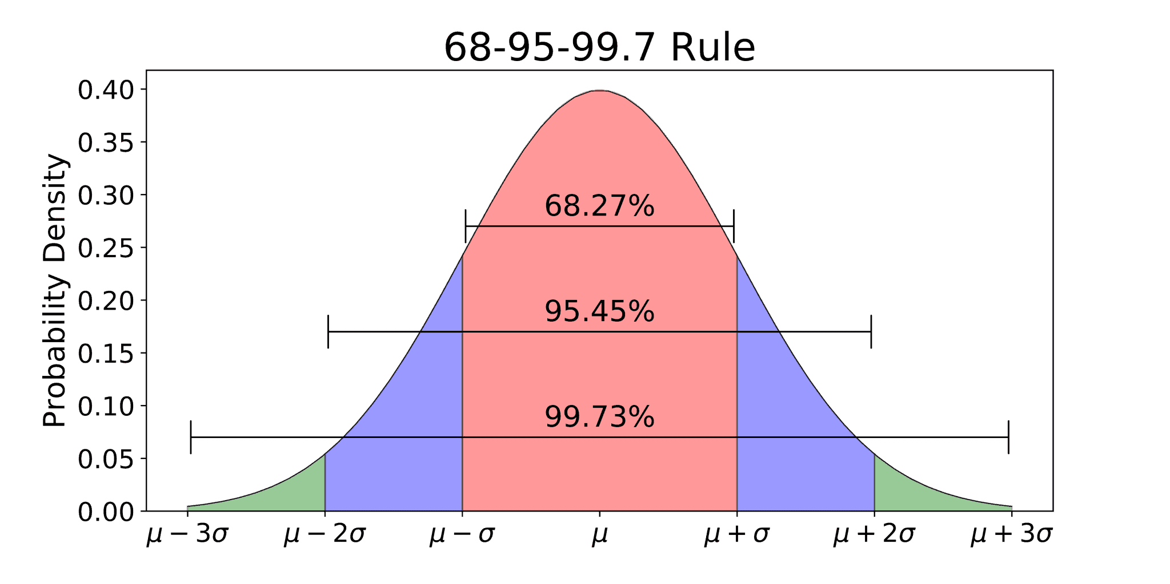


Measure of the Central Tendency
What is $σ$?
What is $μ$?
What can you tell me about this figure?

Slide 8
Parametric Tests
Assumes continuous and normal distribution of data
T-Test
Used to determine if there is a significant difference between two groups of data in terms of mean, standard deviation, and skewness
Analysis of Variance (ANOVA)
Tests multiple groups differences in terms of mean and variance, like the T-test
Example: Can be used to determine if the energy lost from “duck-diving” on a 6-foot board is significantly different from that of an 8-foot board
Example: This method can be used to determine if the surfer’s energy while riding waves is significantly different across different wave heights

Slide 9
Non-Parametric Tests
Used to analyze ordinal and categorical data
Mann-Whitney Test
Determines if two samples have the same median, or
Kruskal-Wallis Test
Analyzes the variance in ordinal data by determining the difference in median values of multiple samples
Friedman Test
Determines the difference between several related samples
Whether observations in one sample tend to be larger than the other
Spearman Rank Test
Tests the strengths of the links between two categorical datasets

Slide 10
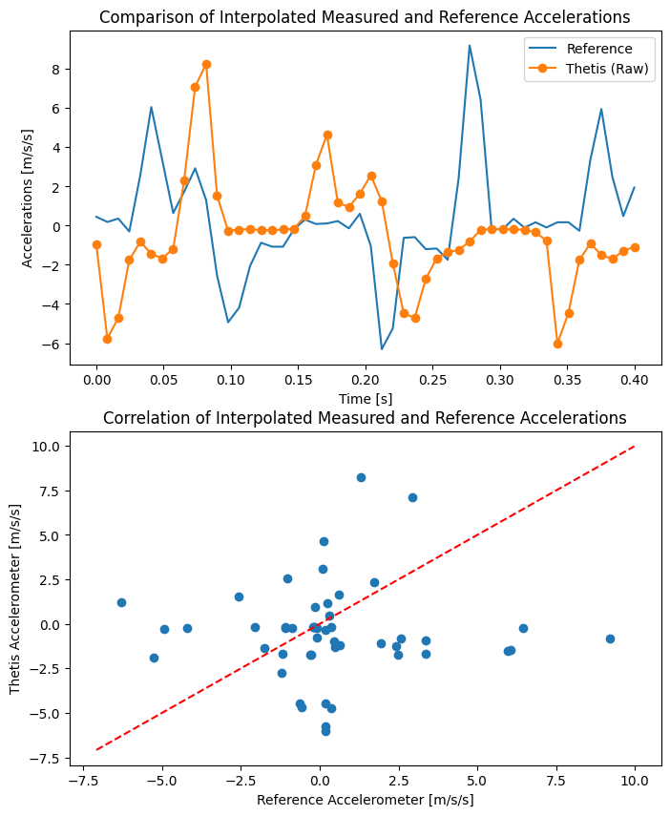
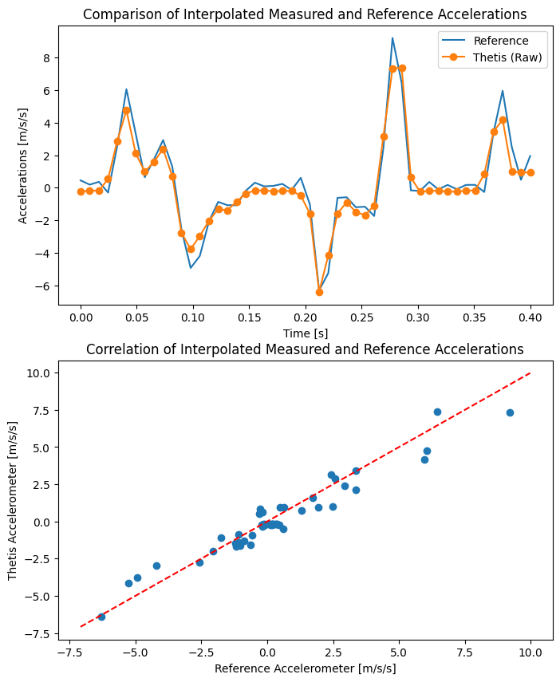



Correlation Statistics
Shows how strongly pairs of variables are related
Pearson’s Correlation: Test the strength or relationship between two continuous variables
The Pearson Correlation Coefficient is defined from [-1,1] and is also known as $R^{2}$
We can plot the two datasets together on a scatter plot and obtain the correlation through a linear regression analysis
A positive-sloped correlation infers both variables grow or shrink together
A negative-sloped correlation infers one variable grows while the other shrinks
A unity-sloped correlation infers both variables are the same
$$R^{2}=0.02$$
$$R^{2}=0.97$$
What conclusion can you draw from this graph?

Slide 11
Regression Analysis
Examines the relationships between two or more variables of interest
Multiple independent variables may be used, but only one dependent variable can be examined

Slide 12
Example
Let’s Check Out Some MATLAB Code
Notes:
Walk through a MATLAB example of analyzing wave power and performing a basic exponential regression using the MATLAB curve fit toolbox

Slide 13
Steps in Conducting Statistical Analysis
Question
Identify your research question
Identify
Identify the nature of your data
(i.e. categorical vs. continuous)
Analyze
Use research frameworks – especially empirical models to summarize your data’s relationships
Reflect
Prove or disprove the validity of your model using your hypothesis

Slide 14

Homework 4: Data Processing
Due: Feb. 13
Handout is in process of re-write should be ready by end of today

Slide 15

Field Experiment Rough Draft Mk 2
Due: Feb 17
Incorporate all changes discussed
Make sure to highlight changes in red or italicized text

Slide 16

Experiment Schedule
Due Feb. 20 before class
Principal Investigators – Make sure that this is turned in ASAP. This is important for coordinating logistics and planning

Slide 17

Questions?

